Slide 1




My Folder, My Work
Learn to download a file and save it in YOUR own folder

Slide 2
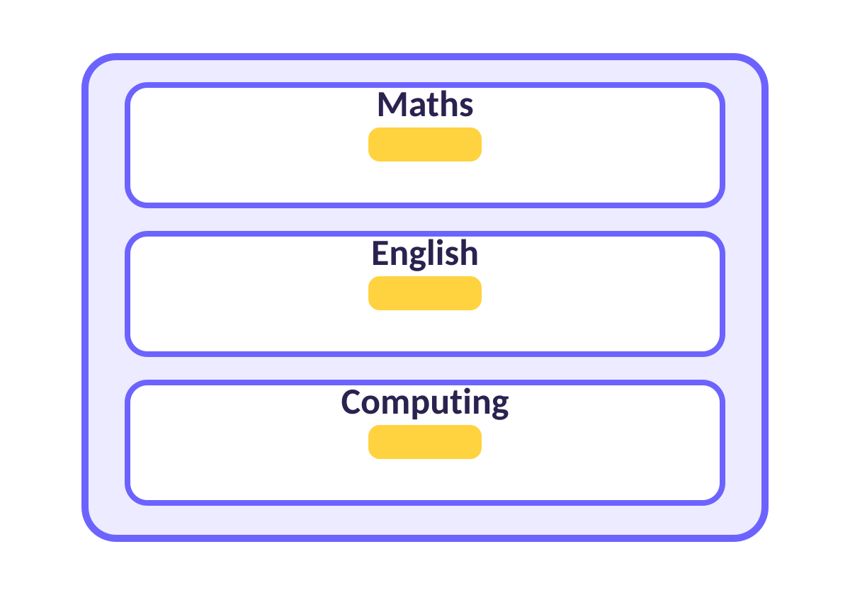
Why do we need folders?
FOLDERS
Folders are drawers in a cupboard
Maths drawer: all my maths.
Computing drawer: all my computing.
Your folder: only YOUR work, so it is easy to find!
Notes:
Teacher: ask who has lost a file before. Folders stop that.

Slide 3
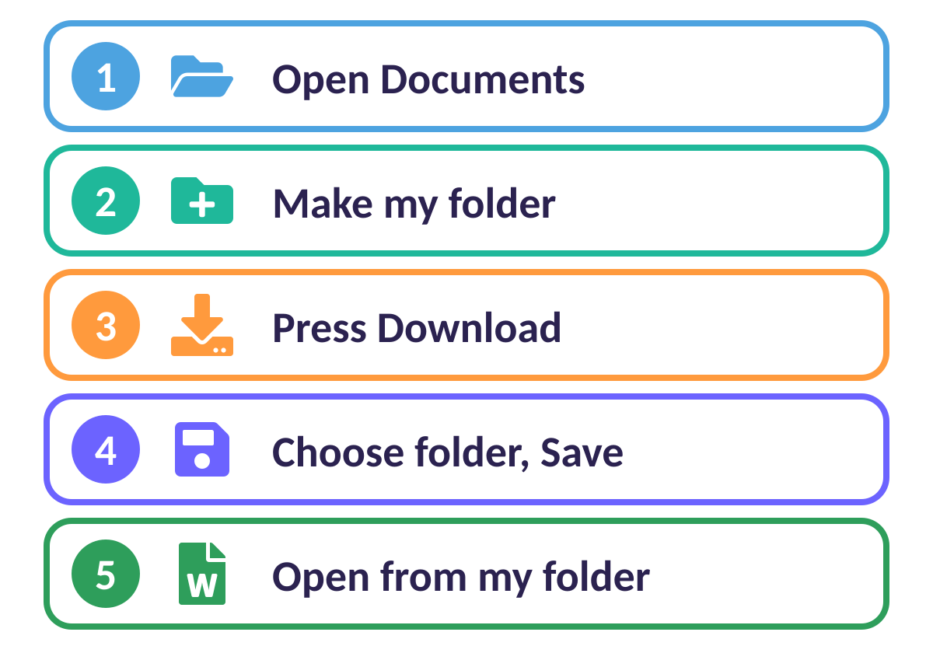
5 easy steps
THE PLAN
Follow the numbers, one at a time
1 Open Documents.
2 Make your folder.
3 Press Download.
4 Choose your folder and Save.
5 Open it from your folder.
Notes:
Display this plan on the board all lesson. Tick each step together.

Slide 4
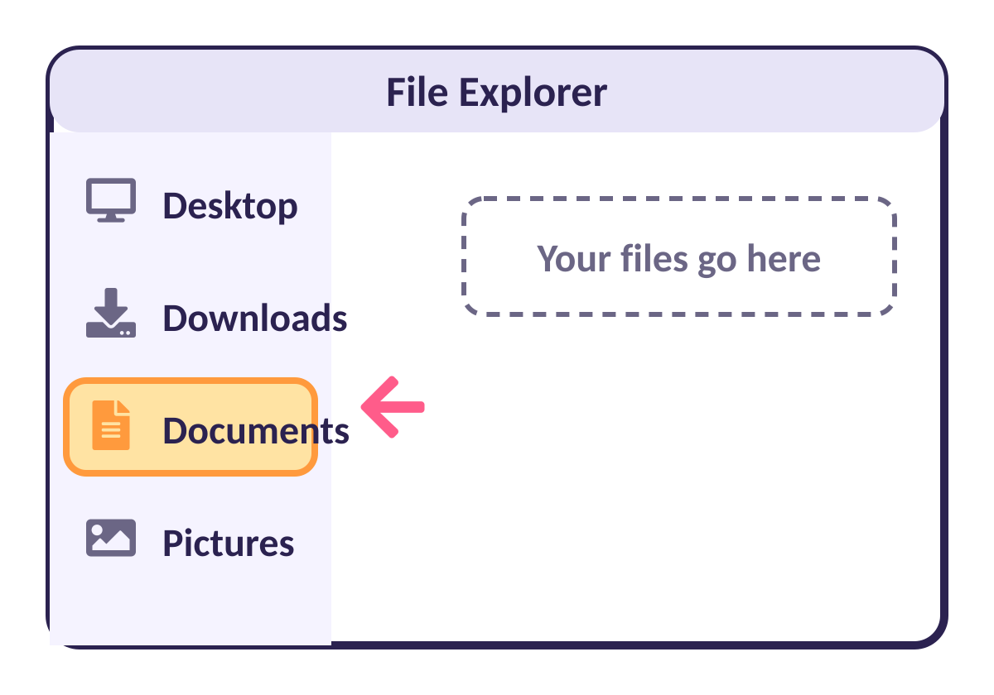
Step 1: Open Documents
DOCUMENTS
The big home for all your folders
Click: the yellow folder on the taskbar.
Then click: Documents on the left.
Documents: is where we keep our own work.
Notes:
On school computers File Explorer is the yellow folder icon in the taskbar.

Slide 5
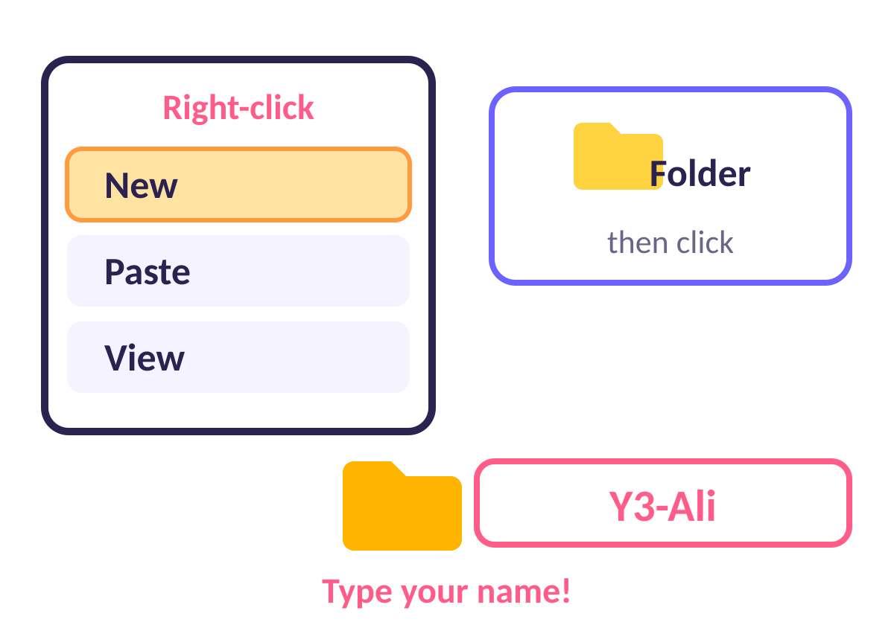
Step 2: Make your folder
NEW FOLDER
Right-click, New, Folder
Right-click: on the empty white space.
Click: New, then Folder.
Type: Y3-Ali (class + your name).
Press: Enter.
Notes:
Right-click = press the right mouse button. On a touchpad: two fingers. Change Y3 to the class (Y4, etc.).

Slide 6
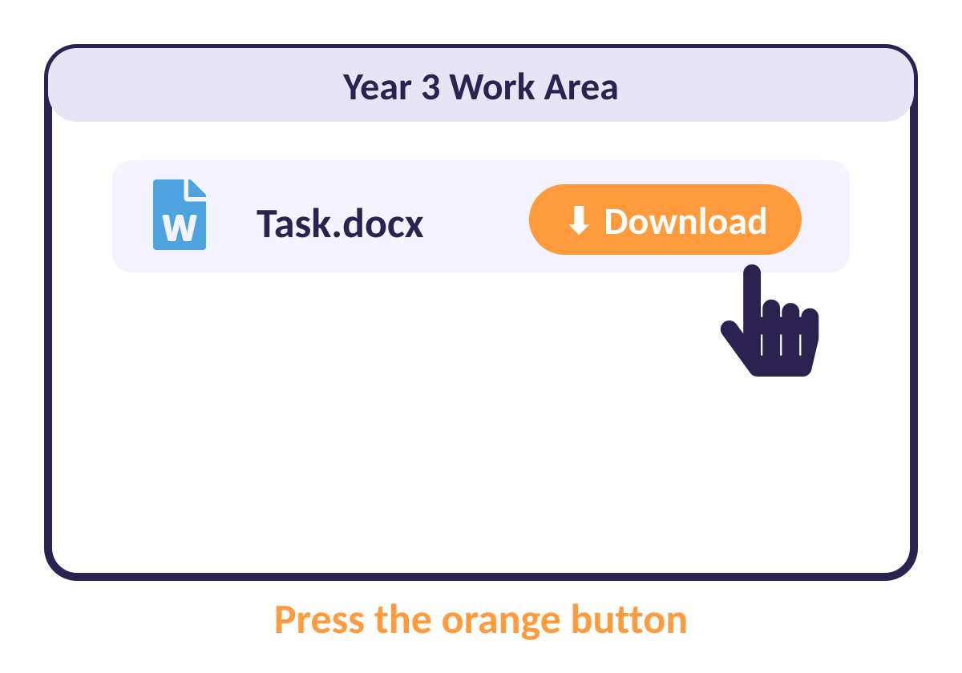
Step 3: Press Download
DOWNLOAD
Get the file from the Work Area
Go to: your class Work Area page.
Find: your task file.
Press: the orange Download button.
Notes:
The browser opens a Save box next. This is where the pupils choose the folder.

Slide 7
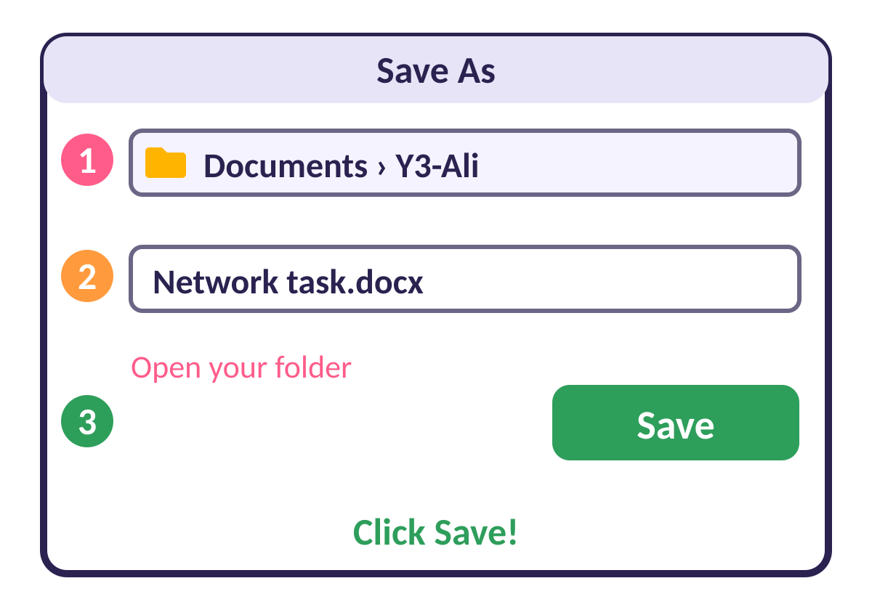
Step 4: Choose where to save
SAVE AS
The magic box that asks: where should it go?
1 Look at the top: click Documents, then YOUR folder.
2 Check the file name.
3 Press Save!
Notes:
If the Save box does not open, the browser may save to Downloads. Then pupils drag the file from Downloads into their folder.

Slide 8
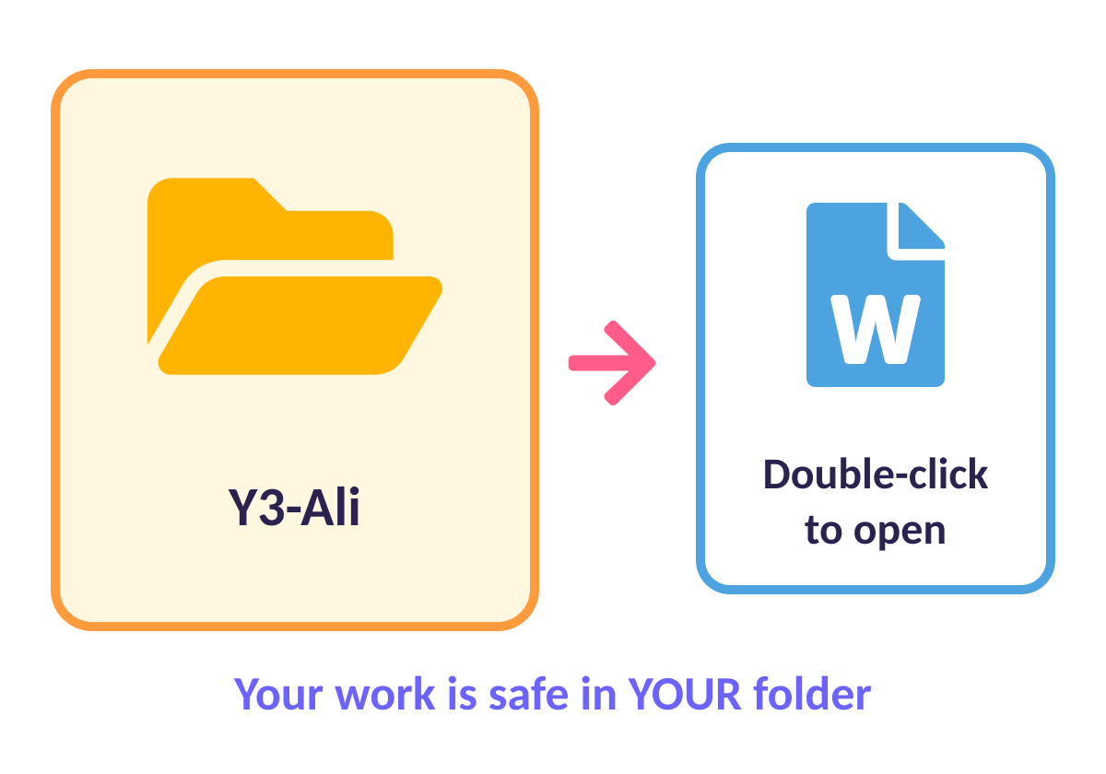
Step 5: Find it again
OPEN IT
Open your folder, double-click your file
Open: Documents, then your folder.
Double-click: the file to open it.
Work: then save again with Ctrl + S.
Notes:
Ctrl + S saves. Pupils press it every few minutes.

Slide 9
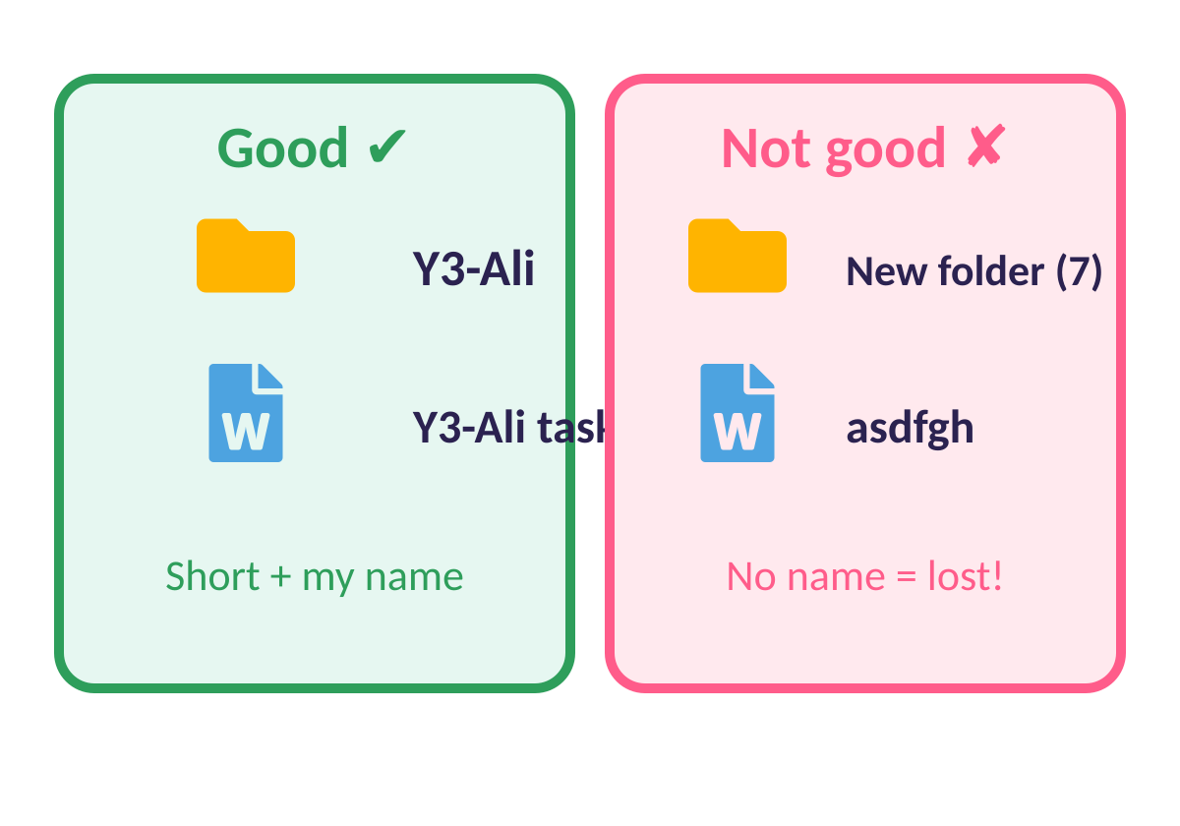
Good names help
NAMES
A good name is short and has MY name
Folder: class + name, like Y3-Ali.
File: add your name to the end.
Avoid: New folder (7) or random letters.

Slide 10
Quick quiz
Where do we save our work?
On the desktop, anywhere
A
In MY folder inside Documents
B
In someone else’s folder
C
Notes:
Pupils vote with fingers (1, 2, 3) or on mini whiteboards before the answer slide.

Slide 11
✔ The answer
Where do we save our work?
On the desktop, anywhere
A
In MY folder inside Documents
B
In someone else’s folder
C
In my own folder, in Documents.
Notes:
Pupils vote with fingers (1, 2, 3) or on mini whiteboards before the answer slide.

Slide 12
Quick quiz
Which button do we press to get the file from the Work Area?
Save
A
Download
B
Delete
C
Notes:
Pupils vote with fingers (1, 2, 3) or on mini whiteboards before the answer slide.

Slide 13
✔ The answer
Which button do we press to get the file from the Work Area?
Save
A
Download
B
Delete
C
Download starts the Save As box.
Notes:
Pupils vote with fingers (1, 2, 3) or on mini whiteboards before the answer slide.

Slide 14
Activity: Do it yourself!
ACTIVITY
Open Documents.
1
Make a folder with your class and name.
2
Download today’s task from the Work Area.
3
Save it in YOUR folder, then open it.
4
Notes:
Walk around. Pupils who finish help a neighbour (not touch their mouse!).

Slide 15
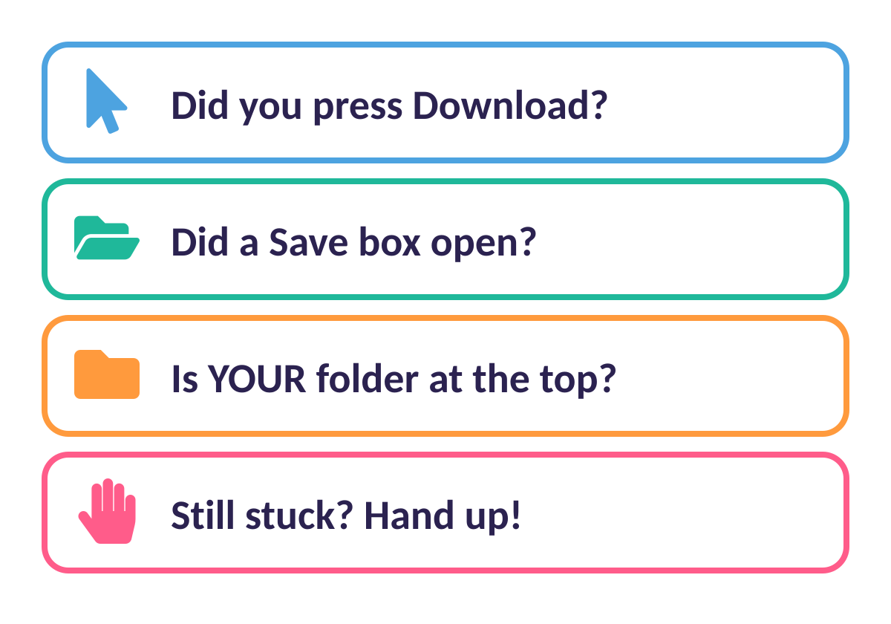
Stuck? Check this list
HELP CARD
Read it before you put your hand up
Tip: read each question slowly.
Still stuck? Ask a friend, then your teacher.

Slide 16




Brilliant work!
You are now experts. Keep asking questions!

